Slide 1
Augmediated reality system based on 3D camera self-gesture sensing
Authors
Raymond Lo, Alexander Chen, Valmiki Rampersad,
Jason Huang, Han Wu, Steve Mann
Presenters
Alexander Chen
Valmiki Rampersad
IEEE ISTAS 2013

Slide 2
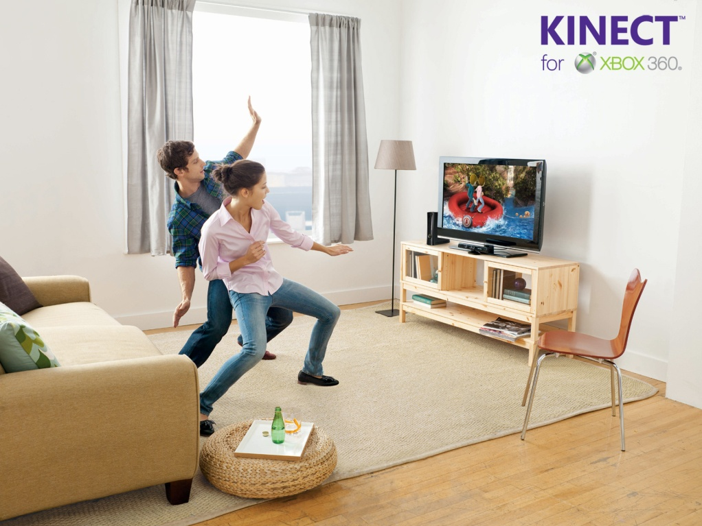
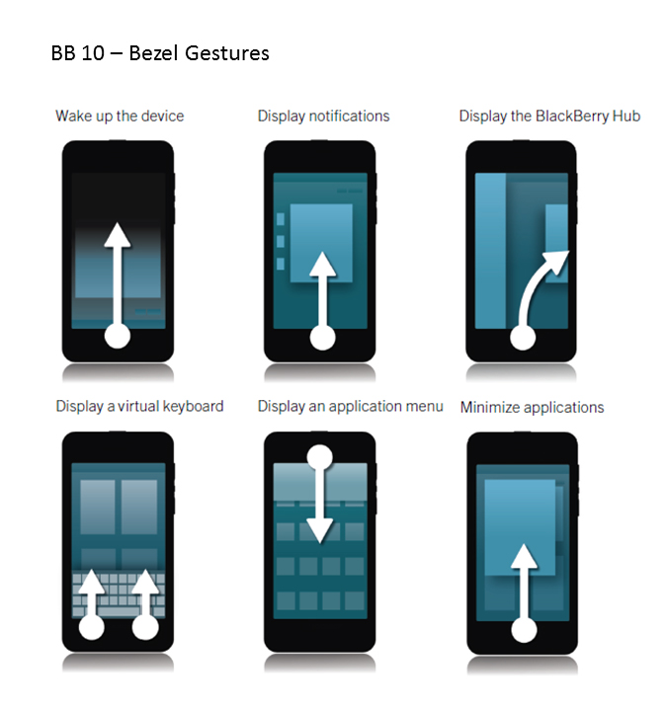
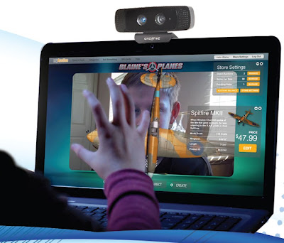
Gestures In Modern Times

Slide 3
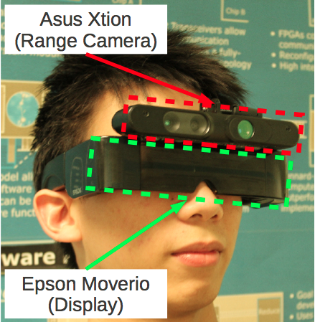
Part of Our Wearable Computer

Slide 4
Table of Contents
Implementation
Segmentation Aid for Object Recognition
Demo
Social Implications

Slide 5
The Hardware Used
Camera: PrimeSense based 3D camera (Kinect or Asus Xtion Pro)
Display: Epson Moverio BT-100
Computer: PC or ODROID-X2 system

Slide 6



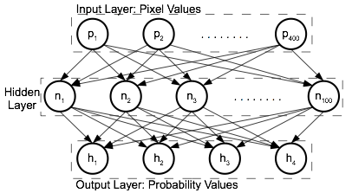
Algorithm Pipeline
Extract Frame
Crop Frame
Resize
Recognize

Slide 7
The Algorithm
Segmentation: Using depth and IR images
Classification: Using a neural network

Slide 8
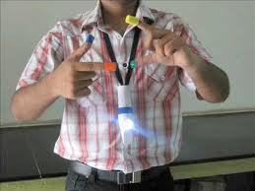
Marker Based Segmentation
Uses RGB cameras

Slide 9
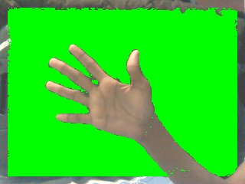
Skin Tone Based Segmentation
Uses RGB cameras

Slide 10
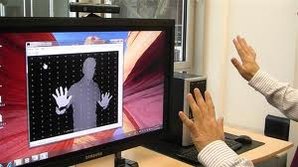
Depth Data Based Gesture
Uses cameras that provide depth data.

Slide 11
Two Observations
Skin reflects infrared (IR) light
Reflective objects close to a light source reflect at a higher intensity

Slide 12
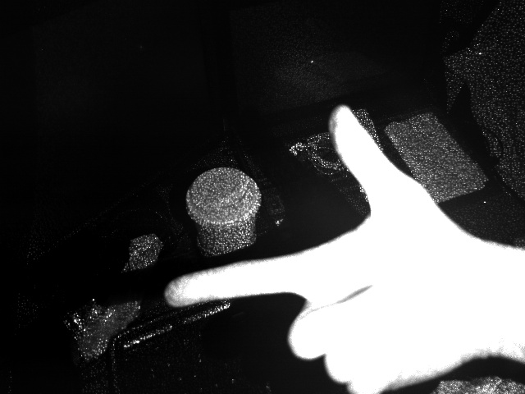

Intensity Thresholding
Intensity
Intensity Filtered

Slide 13


Depth Thresholding
Depth
Depth Filtered

Slide 14
Intensity & Depth
Intensity Filtered
Depth Filtered

Slide 15


Segmented Image
Segmented
Segmented and Cropped

Slide 16




Trained Gestures
Upper Left Corner
Pointing Up
Pointing Angled
Lower Right Corner

Slide 17
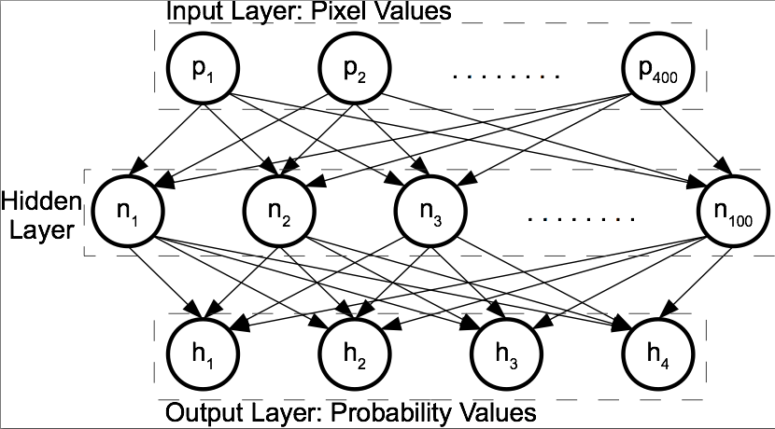
The Neural Network
Single Layer Neural Network

Slide 18
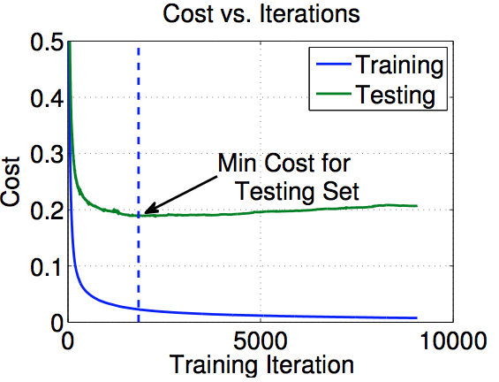
Early Stopping

Slide 19
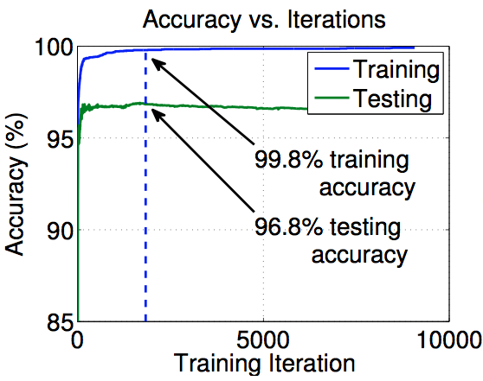
Accuracy of Neural Networks

Slide 20
Table of Contents
Implementation
Segmentation Aid for Object Recognition
Demo
Social Implications

Slide 21
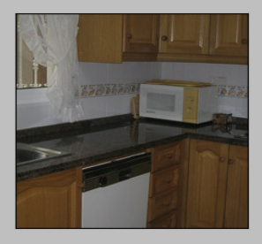
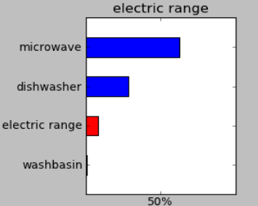
Segmentation Aid For Object Recognition
Background: Neural Net on Multi-Object Image

Slide 22
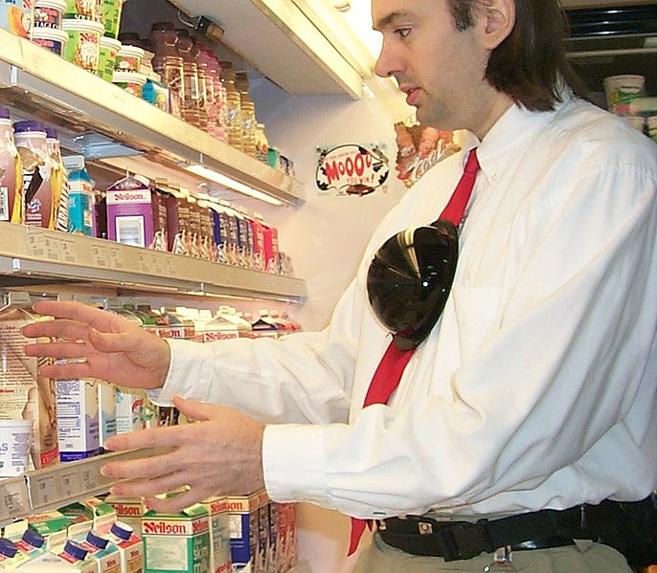
Segmentation Aid For Object Recognition
Background: Image with lots of objects

Slide 23
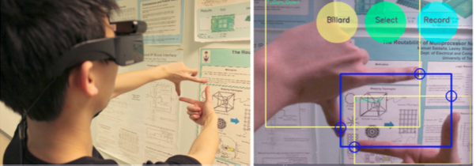
Segmentation Aid For Object Recognition
Our Approach:

Slide 24
Table of Contents
Implementation
Segmentation Aid for Object Recognition
Demo
Social Implications

Slide 25
Demo
Demo

Slide 26
Table of Contents
Implementation
Segmentation Aid for Object Recognition
Demo
Social Implications

Slide 27

Social Implications

Slide 28
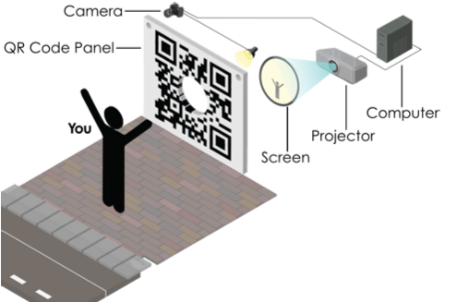
Social Implications

Slide 29
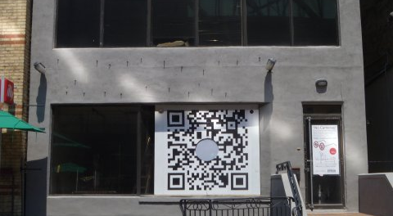
Social Implications

Slide 30
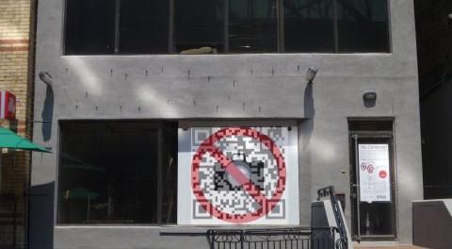
Social Implications

Slide 31
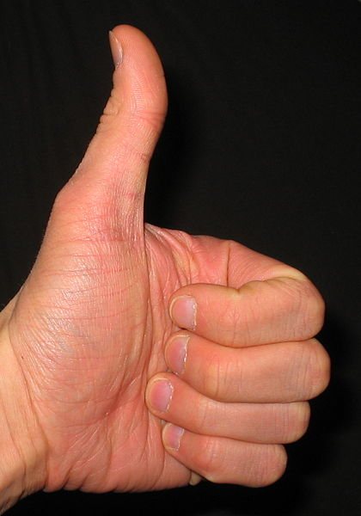
Gestures
Gestures – a form of expression.
Meaning in North America ≠ Meaning in Iran

Slide 32
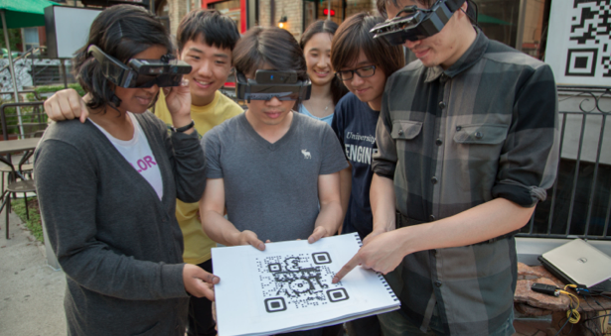
Social Implications

Slide 33
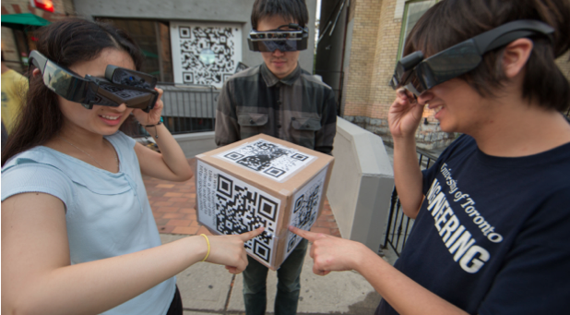
Social Implications

Slide 34
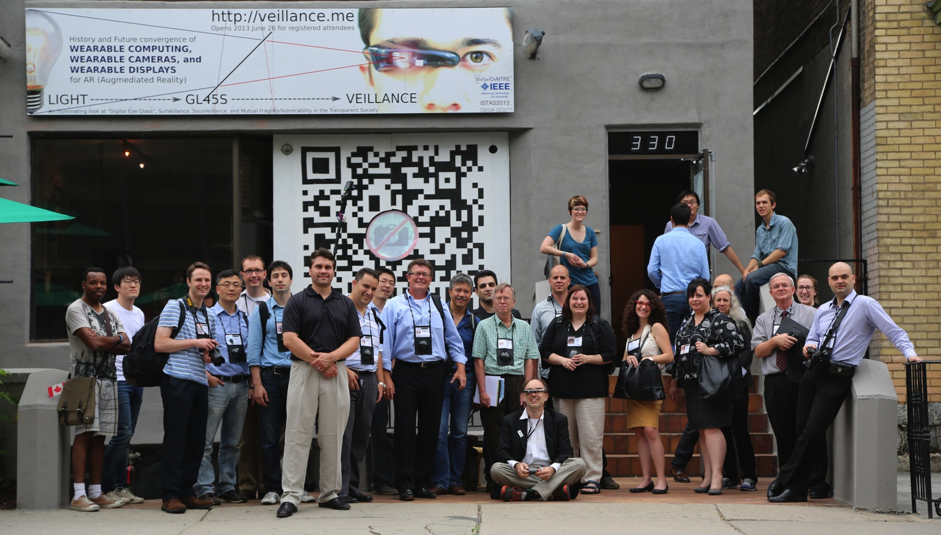
Thank You!

